Slide 1
Configuration in Disguise
Building with clicks instead of code
Phillip Southern
clicks 2 code
@phil7s

Slide 2
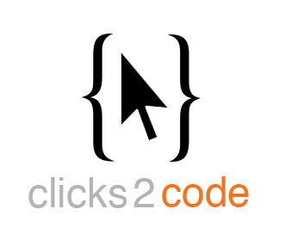

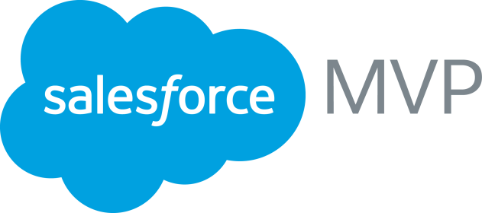
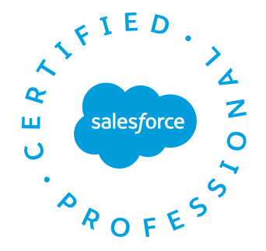
Phillip
Southern
phillip@clicks2code.com
@phil7s
Salesforce MVP
Salesforce Certified
Founder - clicks 2 code

Slide 3
Forward-Looking Statements
Statement under the Private Securities Litigation Reform Act of 1995:
This presentation may contain forward-looking statements that involve risks, uncertainties, and assumptions. If any such uncertainties materialize or if any of the assumptions proves incorrect, the results of salesforce.com, inc. could differ materially from the results expressed or implied by the forward-looking statements we make. All statements other than statements of historical fact could be deemed forward-looking, including any projections of product or service availability, subscriber growth, earnings, revenues, or other financial items and any statements regarding strategies or plans of management for future operations, statements of belief, any statements concerning new, planned, or upgraded services or technology developments and customer contracts or use of our services.
The risks and uncertainties referred to above include – but are not limited to – risks associated with developing and delivering new functionality for our service, new products and services, our new business model, our past operating losses, possible fluctuations in our operating results and rate of growth, interruptions or delays in our Web hosting, breach of our security measures, the outcome of any litigation, risks associated with completed and any possible mergers and acquisitions, the immature market in which we operate, our relatively limited operating history, our ability to expand, retain, and motivate our employees and manage our growth, new releases of our service and successful customer deployment, our limited history reselling non-salesforce.com products, and utilization and selling to larger enterprise customers. Further information on potential factors that could affect the financial results of salesforce.com, inc. is included in our annual report on Form 10-K for the most recent fiscal year and in our quarterly report on Form 10-Q for the most recent fiscal quarter. These documents and others containing important disclosures are available on the SEC Filings section of the Investor Information section of our Web site.
Any unreleased services or features referenced in this or other presentations, press releases or public statements are not currently available and may not be delivered on time or at all. Customers who purchase our services should make the purchase decisions based upon features that are currently available. Salesforce.com, inc. assumes no obligation and does not intend to update these forward-looking statements.
Notes:
Talk Track Before I begin, just a quick note that you should base your purchasing decisions on products and services that are currently available. Key Takeaway
Salesforce is a publicly traded company. Customer should make buying decisions only on the products commercially available.

Slide 4
What is Configuration in Disguise?
Configuration that has a meaningful impact on development.
Can view development and not know configuration is a driving factor.
Development: code or declarative
Notes:
Backstory on VF Dreamforce sessions.
Configuration: point and click customization in setup

Slide 5
Why Configuration?
 | Cost and Time | Maintenance | Complexity and Scalability
Code | Resource allocation and time to complete. | Who maintains code after initial development? | More complex and to scale potentially need more code.
Clicks | Declarative is fast with platform tools available. | No code or test automation to maintain. Regular releases. | Can build complex things with clicks. Limitations are design focused not execution focus.
Notes:
Code
Complexity and Scalability: E.g. if your implementation heavily depends on business logic coded with Apex code, you are more likely to run into governor limits.
Clicks
cost and time: It doesn’t involve writing code, writing test classes, etc.

Slide 6
What kind of Configuration?
Custom Settings
Custom Labels
Field Sets
Custom Metadata Types

Slide 7
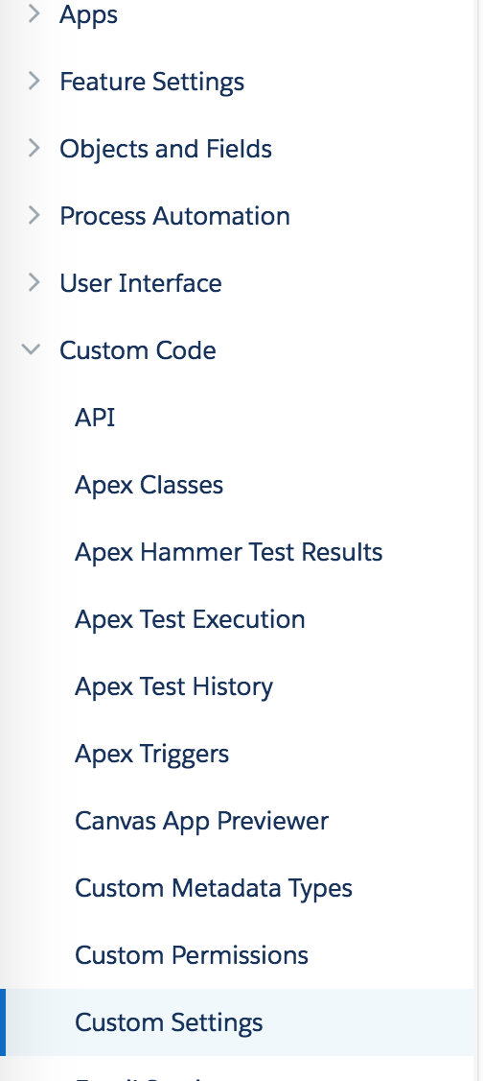
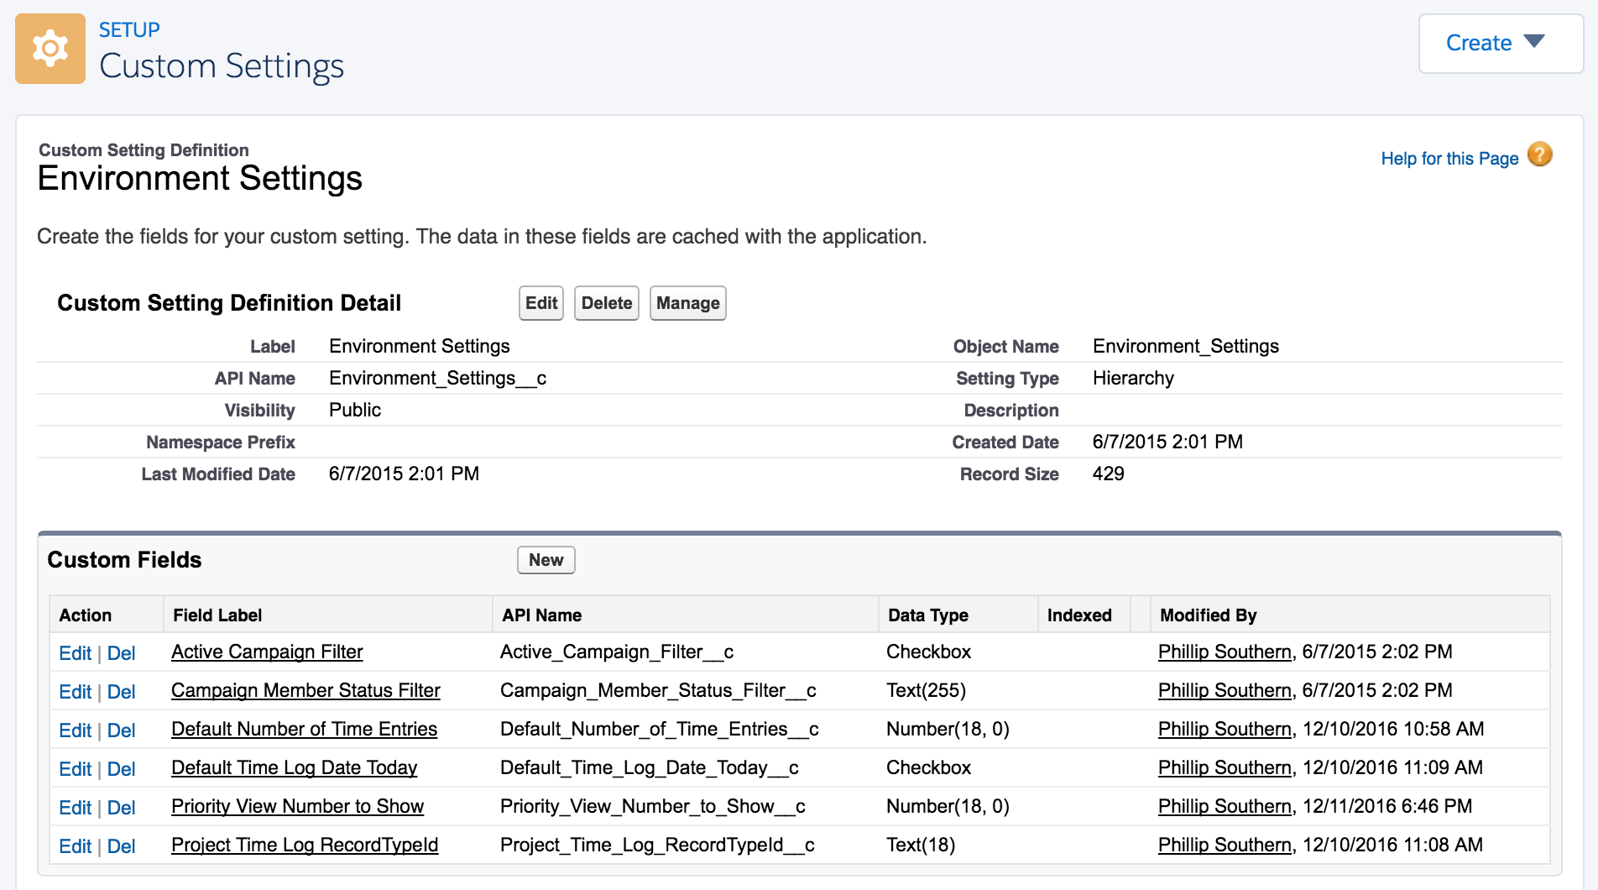
Custom Settings
Similar to custom objects, custom sets of data.
Notes:
-exposed in the application cache, which enables efficient access without the cost of repeated queries to the database.
-This data can then be used by formula fields, validation rules, flows, Apex, and the SOAP API.
Custom Setting similar to custom object just not with additional options like formulas, validation rules, page layouts, etc.
Can do fields but not lookups, picklists, etc.
So you maybe thinking, doing poor selling job on this…...
When I edit record in custom object I approach it as editing data, when I edit a record for a custom setting, I approach it was I’m editing an application or functionality.
The data is exposed in cache….no resources needed to grab it.

Slide 8
Hierarchy and List Custom Settings
Which should I use?
 | Type | Apex | Formula
Hierarchy | Built-in hierarchical logic let’s you personalize for profile or user. | Yes | Yes {!$Setup.CustomSettingName__c.CustomFieldName__c}
List | Reusable set of static data. Available Org-wide. | Yes | No

Slide 9
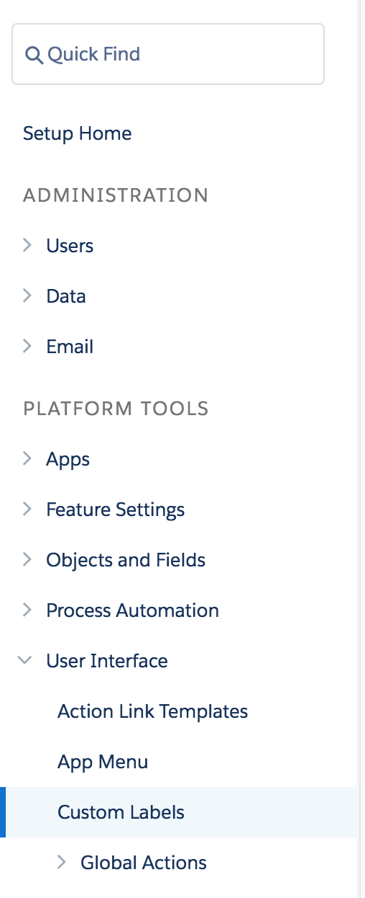
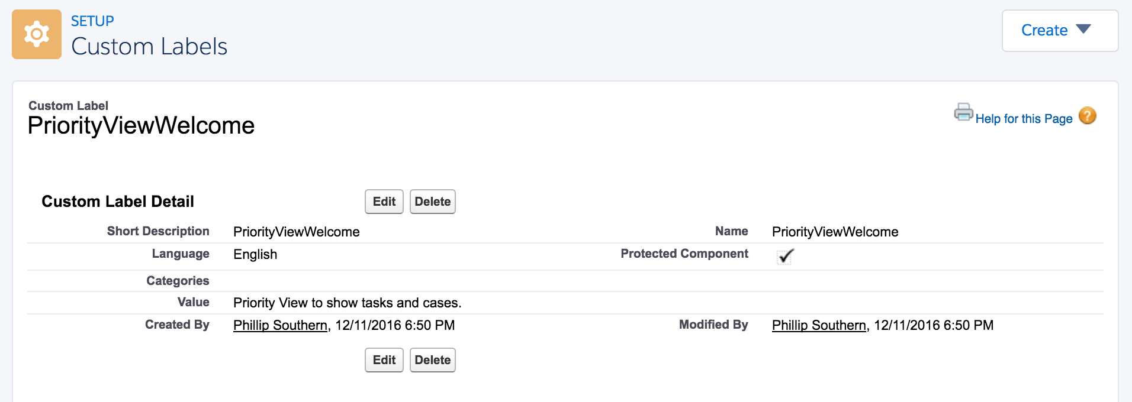
Custom Labels
Custom text values, accessed in Apex, VF, and Lightning components.

Slide 10
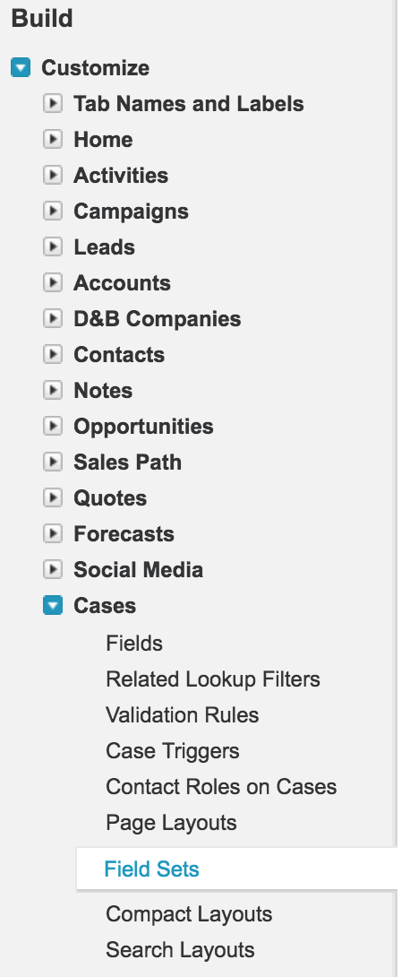
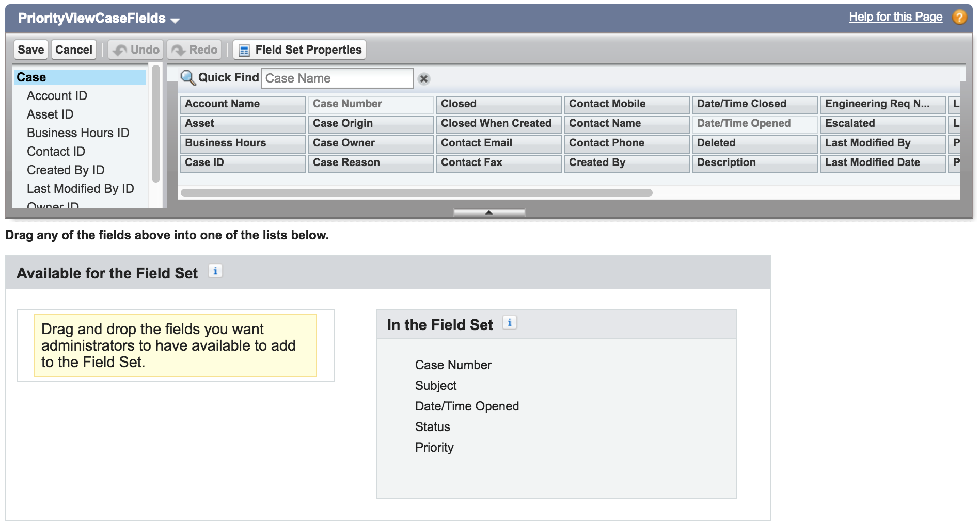
Field Sets
Grouping of fields, can be added to VF pages.
Notes:
Packages of fields to reference or put on a page. Display in the order listed on the field set.
Right now setup is only available in Classic.
https://releasenotes.docs.salesforce.com/en-us/winter16/release-notes/lex_gaps_limitations_ui_customization.htm

Slide 11
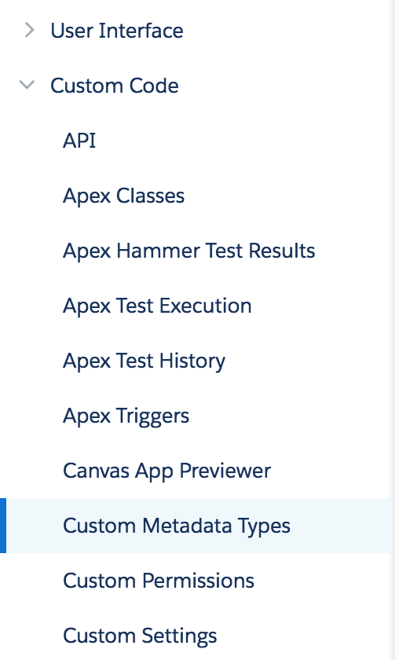
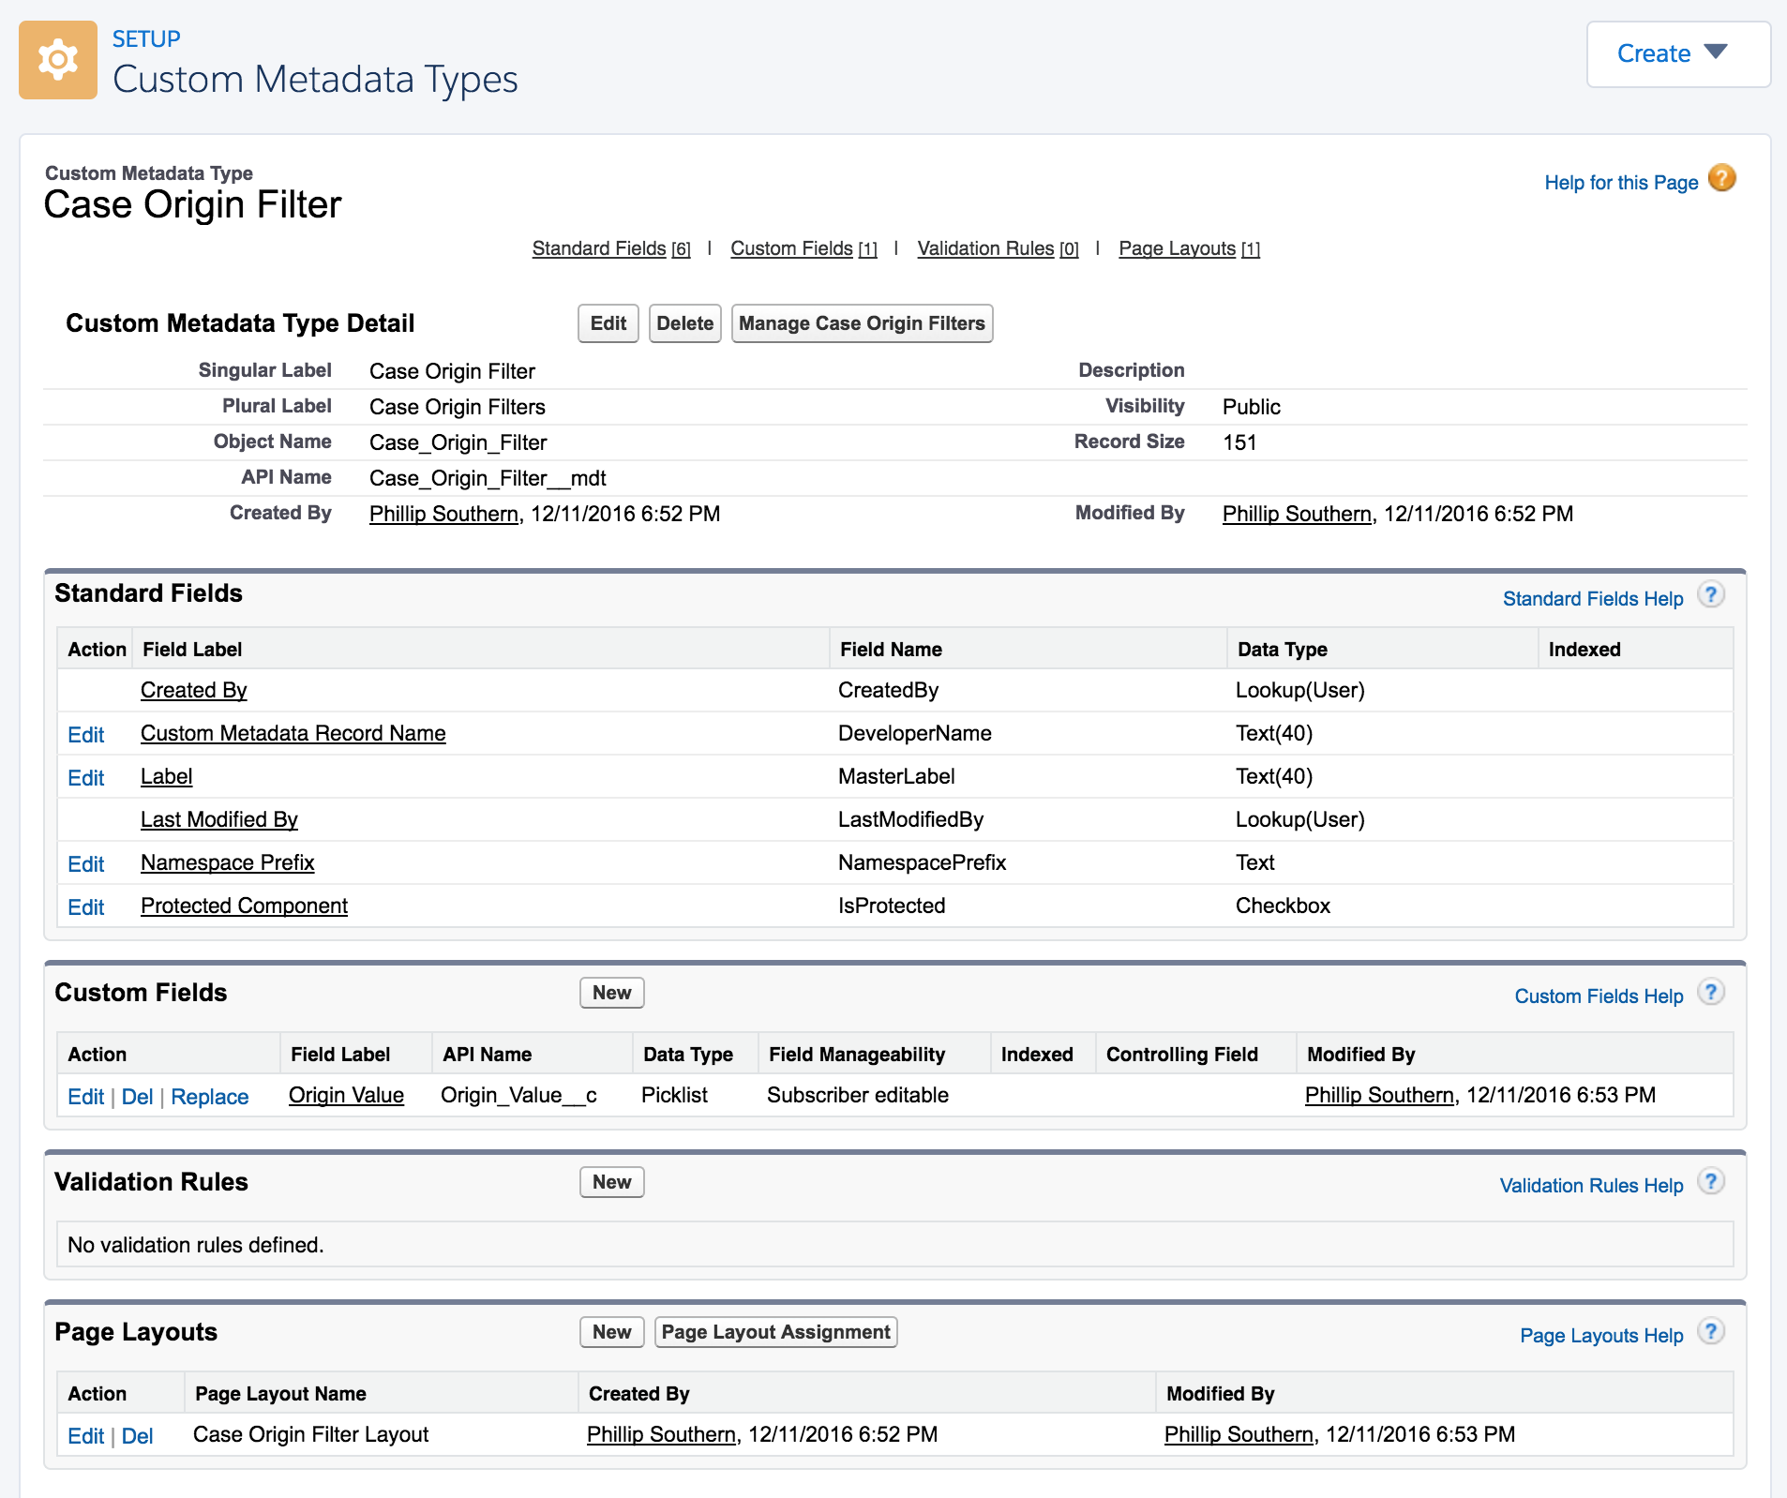
Custom Metadata
Notes:
A custom metadata type is defined as a custom object and is stored as an object. Custom metadata types have a suffix of __mdt (instead of __c for custom objects).
Custom metadata type field names have a suffix of __c, like other custom fields.
Since this is metadata, records of a Custom Metadata Type can be moved from sandbox to production, through change sets.
Can not be used in formulas, validation rules, etc. You have to query out and get the data when using in Apex or elsewhere.

Slide 12
List Custom Setting vs Custom Metadata Type
Which should I use?
 | Page Layouts, Validation Rules, Picklists | Apex | Change Sets | Protect (hide) records
List Custom Setting | No | Read: Yes Create/Update: Yes | Definition - Yes Records - No | No
Custom Metadata Type | Yes | Read: Yes Create/Update: No | Definition - Yes Records - Yes | Yes

Slide 13
Why is this important?
Why should we care?
Admin
Developer
Both
Configuration is accessible and easy.
Developers may not know or are new to platform.
Opportunity for engagement in process.
Empower non-coders and non-developers.
Less revisions and management.
Easier code management.
Change Control
Notes:
Admin side:
Larger resource pool to change configuration. Admin or Developer can change it…..but also Super users, managers, etc. Salesforce is widely known for the do it yourself toolkit, because of this declarative, configuration type approach.
New devs simply may not know.
Sometimes requests can feel like a black hole, no involvement.

Slide 14
Use Cases
Id Monitoring and Filtering
Picklist Value Monitoring
Turn Functionality On/Off
Sections of Fields on Visualforce Pages and Lightning Components
Welcome Messaging
Notes:
Id Monitoring - Hiearchy Custom Setting. Think of all multiple workflow rules that monitor same Id of a record type. Also Apex code referencing values. Less error of change with this approach.
Picklist Value Monitoring - List Custom Setting. Think of Apex Code monitor a set of values. All cases with Status of …..
Turn Functionality On/Off - Hiearchy Custom Setting. Schedule or Batch process.
Section of Fields - Field Sets
Welcome Messaging - Custom Label

Slide 15
Use Case Demos

Slide 16
Demo Items
Configuration | Purpose
Custom Label | Welcome message with instructions.
Custom Setting – Hierarchy | Number defaulting.
Custom Metadata | Multiple filtering values.
Field Sets | Display fields for page.

Slide 17
Advanced Options
Calling Flow from code.
Calling code from Process Builder and Flow.

Slide 18
Summary
Configuration can drive Development.
Why Configuration? Cost and Time, Maintenance, Complexity and Scalability.
@phil7s
Github repo: http://bit.ly/configurationInDisguise

Slide 19
References
Custom Settings: https://help.salesforce.com/apex/HTViewHelpDoc?id=cs_about.htm
Custom Labels: https://help.salesforce.com/HTViewHelpDoc?id=cl_about.htm&language=en_US
Field Sets: https://help.salesforce.com/HTViewHelpDoc?id=fields_about_field_sets.htm
Custom Metadata: https://developer.salesforce.com/docs/atlas.en-us.api_meta.meta/api_meta/meta_custommetadatatypes.htm
Clicks vs Code: https://developer.salesforce.com/blogs/engineering/2014/12/forcedotcom-declarative-development.html

